Slide 1
UNIX Operating System

Slide 2
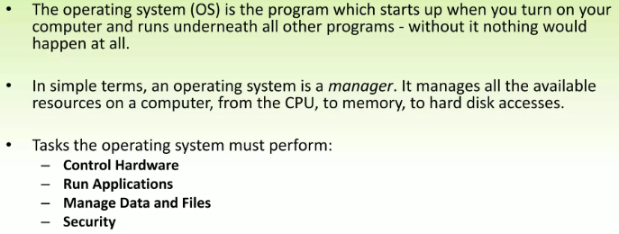
Introduction

Slide 3
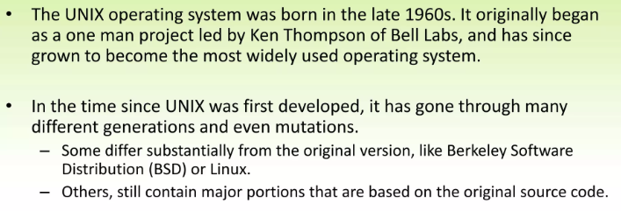
History

Slide 4
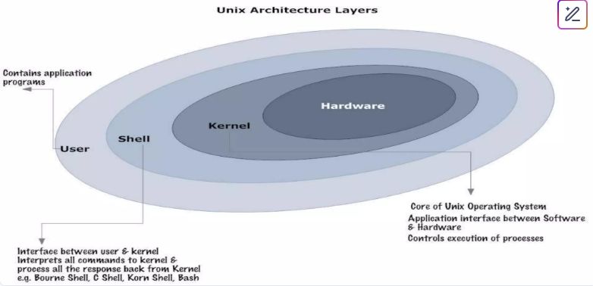
Structure of Unix

Slide 5
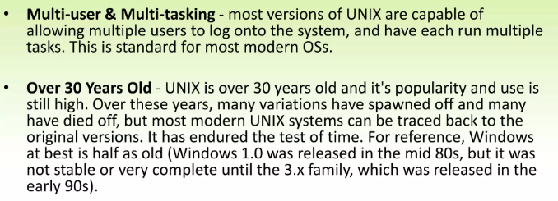
General Characteristics of Unix as an Operating System (OS)

Slide 6
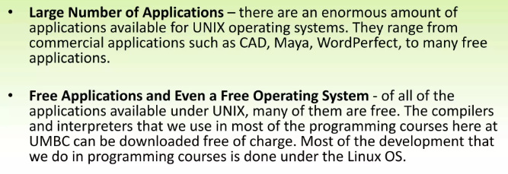
General Characteristics of Unix as an Operating System (OS)

Slide 7
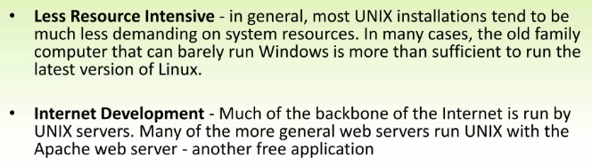
General Characteristics of Unix as an Operating System (OS)

Slide 8
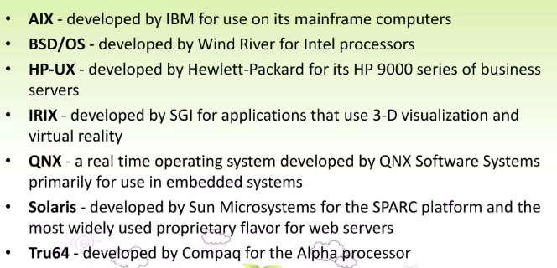
Flavors of Unix

Slide 9
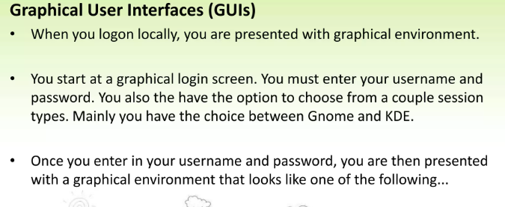
Interfaces of Unix

Slide 10
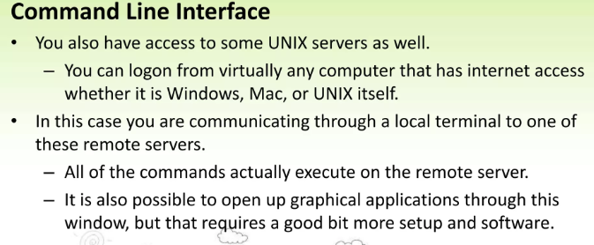
Interfaces of Unix

Slide 12
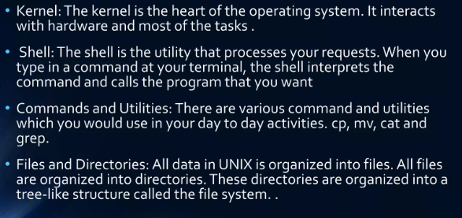
Unix Architecture

Slide 13
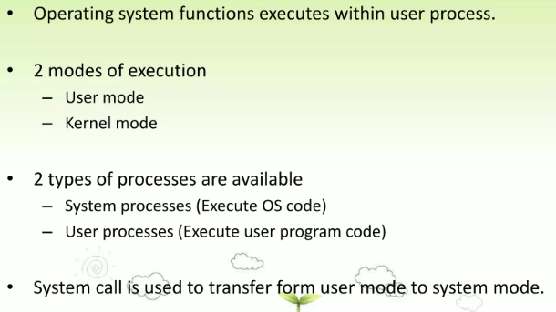
Process management

Slide 14
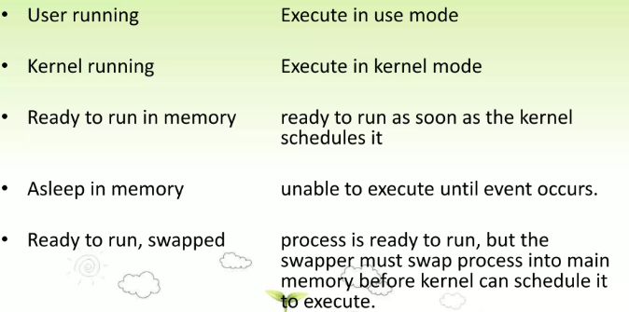
Process State in Unix

Slide 15
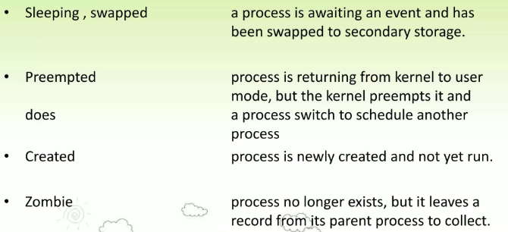
Process State in Unix

Slide 16
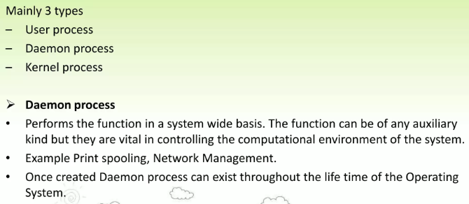
Process Scheduling Queues

Slide 17
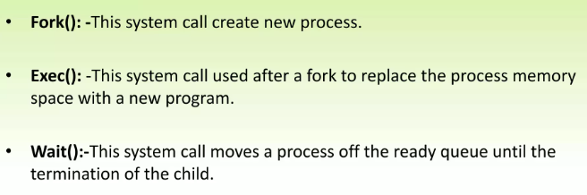
System Calls in Unix

Slide 18
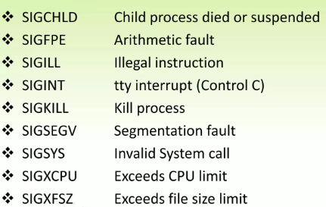
Interesting Signals in Unix

Slide 19
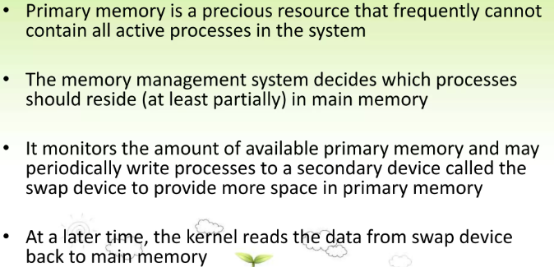
Memory

Slide 20
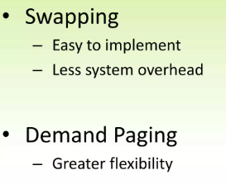
Unix memory Management Policies

Slide 21
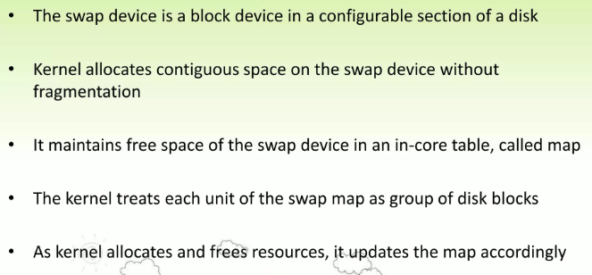
Swapping

Slide 22
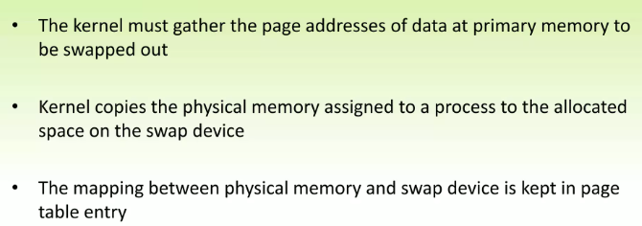
Swapping Process Out

Slide 23
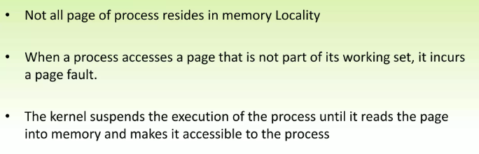
Demand Paging

Slide 24
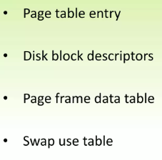
Data Structure for Demand paging

Slide 25
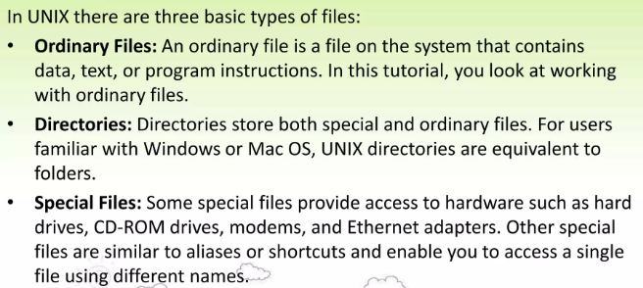
File Management in Unix

Slide 26
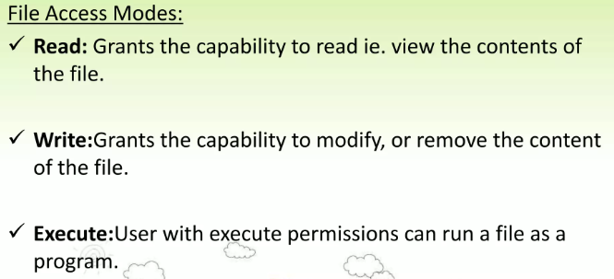
File Management in Unix

Slide 27
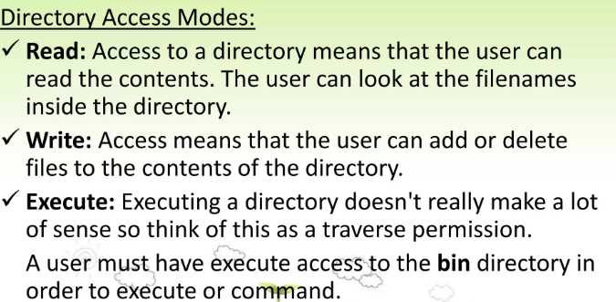
File Management in Unix

Slide 28
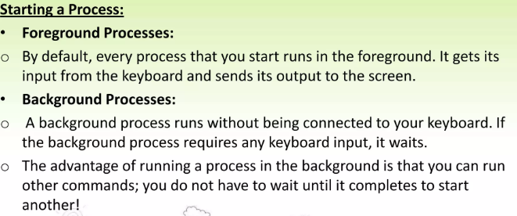
File Management in Unix

Slide 29
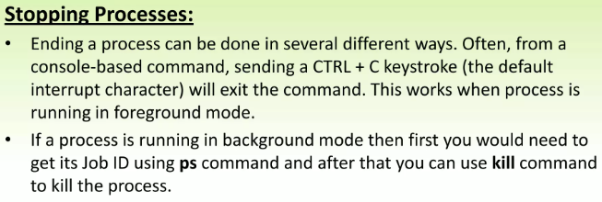
File Management in Unix

Slide 30
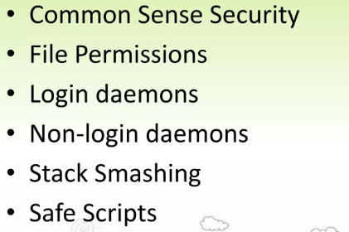
Unix Security

Slide 31
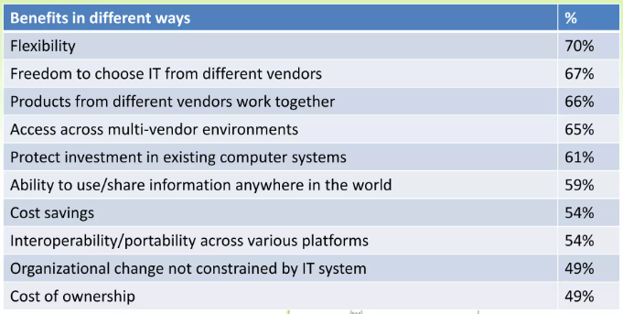
Benefits of Unix

Slide 32
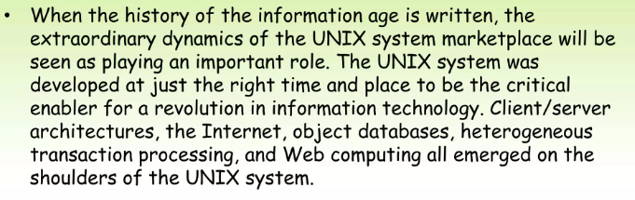
Summary

Slide 34
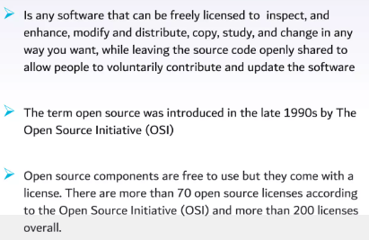
What is open source software

Slide 35
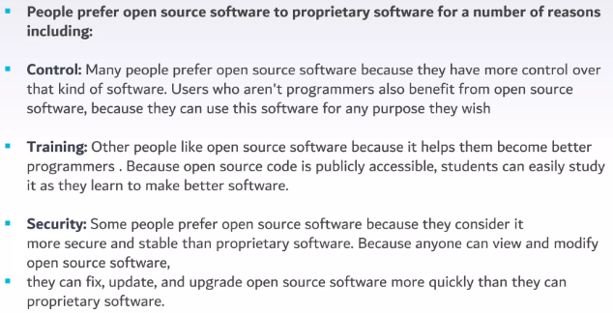

Slide 36
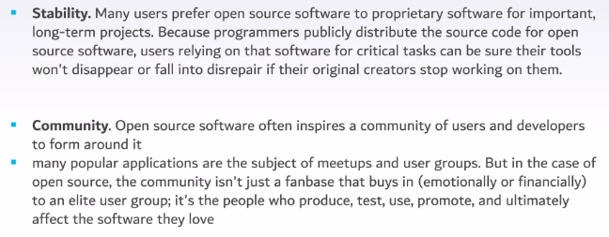

Slide 37
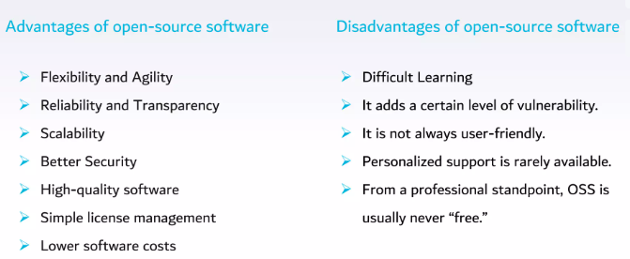

Slide 38
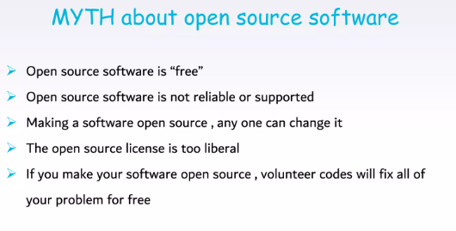

Slide 39
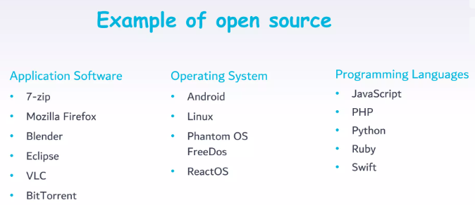

Slide 40
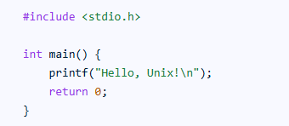
Writing a C program in a Unix environment using the GCC compiler involves several steps:
Open a Terminal:
Access the command-line interface in your Unix-like operating system (e.g., Linux, macOS).
Create a C Source File:
Use a text editor (like vi, nano, emacs, or a graphical editor) to create a new file and save it with a .c extension (e.g., hello.c).

Slide 41
Compile the Program: Use the gcc command to compile your C source file into an executable program.
gcc hello.c -o hello
gcc: Invokes the GNU C Compiler.
hello.c: Specifies the input C source file.
-o hello: Specifies the name of the output executable file (optional; if omitted, the default executable name is a.out).
Execute the Program: Run the compiled executable from the terminal.
./hello
./: Indicates that the executable is in the current directory.

Slide 42
Explanation of the Process:
Preprocessing: The preprocessor handles directives like #include, expanding header files and performing macro substitutions.
Compilation: The compiler translates the preprocessed C code into assembly language.
Assembly: The assembler converts the assembly code into machine-level object code.
Linking: The linker combines the object code with necessary libraries (like stdio.h for printf) to create a final executable program.

